Slide 1
School Start Time
Adapted from a presentation by Tom Fox, National Writing Project
(June 16, 2014)
A Mini-Unit on Teaching Argument
Day 1
Notes:
Overview
The purpose of this mini-unit is to integrate short daily warm-up activities into a language arts classroom. These activities are designed to accumulate into a short argument that students write or, through extension, to a longer researched argument. These kinds of warm-up activities make efficient use of classroom time because they build fluency for students and, by designing the warm-up as building on each other, give students experience with more complex tasks.
The Use of “Writing into the Day”
Researchers and classroom teachers attest to the value of informal writing for fluency and learning. All writing, however, needs to be purposeful and eventually lead somewhere. Many teachers use the format of “Writing into the Day,” where students write informally during the first 5-7 minutes of the class period. Students settle down, get quiet, and start thinking. This mini-unit draws on the practice of “Writing into the Day” as a means to support students’ learning to write arguments.
Argument Writing as Participation in a Conversation
This mini-unit focuses on the relationship among sources. Researchers and academics often refer to academic writing as a “conversation.” Students start by reading and understanding various voices in the conversations, their positions and points of view. The purpose of the invitation to create a graphic on day 3 is to help students understand the “geography” of the conversation, where the different contributors stand, and ultimately, where the students stand.
As they begin to understand the exchanges among authors, students try out their own voice, their own opinion, by locating it among the other voices. Citing the other voices, by forwarding or countering, is the way that students enter these conversations. This mini-unit gives students a brief experience of how to enter a conversation.
Readings
The readings for this mini-unit could be easily changed by topic or reading level. The selection of reading is designed to give students a multi-voiced conversation for them to participate in.
Extensions
When students complete several mini-units like this one, they can choose one that they are especially interested in and bring it to completion as a short argument. Additionally students could extend one of their arguments into a longer piece by augmenting it with their own research. Alternatively, the class can choose one of the topics that they wish to pursue together.

Slide 2
Agree, Disagree, Undecided
School start times should be moved back to later in the morning.
The Agree and Disagree groups will work separately to make a list of evidence for their side of the argument.
The Undecided group will list 5 questions they will ask the other two groups.
Group Agree presents first.
Group Disagree presents next
Group Undecided asks questions.
Groups Agree and Disagree respond to questions.
--After hearing all ideas, choose your actual stance to prepare for the writing task and collection of evidence.

Slide 3
Drafting an Early Claim
Complete this Focus Statement after “Agree, Disagree, Undecided”
“As a _________, I am writing an argument to convince ___________ that ____________.”
Examples:
As a sleep-deprived teenager, I am writing an argument to convince EJHS administrators that they need to start first period later in the day.
As a student athlete, I am writing an argument to convince the board of education that the school start times should be moved back earlier in the morning.

Slide 4
Reading #1
1. Read “The Early Bird Gets the Bad Grade.”
2. Underline or note in the margin the main claim of the article.
3. Highlight in BLUE what you consider to be the writer’s strongest evidence.
4. Highlight in GREEN what you anticipate will help you support your own argument.
5. Highlight in RED evidence which could contradict your own claim (this will be utilized later for counterclaims).
(Remember, claims often change during the process of research…)
Day 2
Notes:
Day 1 (15 minutes)
During the normal “Writing into the Day” give students the following directions:
1. Read “The Early Bird Gets the Bad Grade.” There are two versions, the original (11th grade level) and a revised version (8th grade level).
2. Underline or note in the margin the main claim of the article.
3. Highlight what you consider to be the writer’s strongest evidence.
4. Then write informally for 5-7 minutes:
• What do you want to know more about?
• Where do you stand on this issue today?
Keep your writing in your notebook.

Slide 5
Response to Reading #1
Write informally and responsively for 5-7 minutes:
• What do you want to know more about?
• Where do you stand on this issue today?
• How can you reference this textual evidence during your own composition to support your claim?
Keep your writing in your notebook.
Notes:
Day 1 (15 minutes)
During the normal “Writing into the Day” give students the following directions:
1. Read “The Early Bird Gets the Bad Grade.” There are two versions, the original (11th grade level) and a revised version (8th grade level).
2. Underline or note in the margin the main claim of the article.
3. Highlight what you consider to be the writer’s strongest evidence.
4. Then write informally for 5-7 minutes:
• What do you want to know more about?
• Where do you stand on this issue today?
Keep your writing in your notebook.

Slide 6
Reading #2
1. Read the teenage writer’s essay, “Should School Stay Early?”
2. Underline or note in the margin the main claim of the article.
3. Highlight in BLUE what you consider to be the writer’s strongest evidence.
4. Highlight in GREEN what you anticipate will help you support your own argument.
5. Highlight in RED evidence which could contradict your own claim (this will be utilized later for counterclaims).
(Remember, claims often change during the process of research…)
Day 3
Notes:
Day 2 (15 minutes)
During the normal “Writing into the Day” repeat the process with a new article:

Slide 7
Response to Reading #2
Write informally and responsively for 5-7 minutes:
• What do you want to know more about?
• How have your views on this issue either changed or expanded?
• How can you reference this textual evidence during your own composition to support your claim?
Keep your writing in your notebook, adding on to your initial response.
Notes:
Day 1 (15 minutes)
During the normal “Writing into the Day” give students the following directions:
1. Read “The Early Bird Gets the Bad Grade.” There are two versions, the original (11th grade level) and a revised version (8th grade level).
2. Underline or note in the margin the main claim of the article.
3. Highlight what you consider to be the writer’s strongest evidence.
4. Then write informally for 5-7 minutes:
• What do you want to know more about?
• Where do you stand on this issue today?
Keep your writing in your notebook.

Slide 8
School Start Time Video
Doctors: Early school start times unhealthy for students
By Sara Cheshire, Special to CNN
updated 8:43 AM EDT, Thu August 28, 2014
http://www.cnn.com/2014/08/28/health/school-start-times/
Does this source seem credible?
Listen for examples of AUTHORIZING
and ILLUSTRATING in this video.
Day 4

Slide 9
Insert this chart into your Notability file, and complete in response to the video.
It Says | I Say
1.
2.
3.
4.
5.
6.
Beth Rimer, Ohio Writing Project for NWP CRWP funded by the Department of Education

Slide 10
Share your notes with your neighbor
Add any new ideas to your responses
Jean Wolph, Louisville Writing Project for NWP CRWP funded by the Department of Education

Slide 11
Reading #3
1. Read the last article from the Associated Press, “High schools with late start times help teens but...” OR the article “Are Teenagers Sleepwalking Through High School?”
2. Underline or note in the margin the main claim of the article.
3. Highlight in BLUE what you consider to be the writer’s strongest evidence.
4. Highlight in GREEN what you anticipate will help you support your own argument.
5. Highlight in RED evidence which could contradict your own claim (this will be utilized later for counterclaims).
(Consider how your initial claim may have changed during the process of this research…)
Day 5
Notes:
Day 3 (15 minutes)
During the normal “Writing into the Day” give the students the following directions:
1. Read the last article from the Associated Press, “High schools with late start times help teens but...” There are three versions, the original (12th grade level), a revised version (8th grade level), and an alternate selection from newsela.com, “Are Teenagers Sleepwalking Through High School?” (4th grade level).
2. Draw a simple graphic that represents the relationship among these three articles.
3. Write a short explanation of your graphic. Save it to use tomorrow.

Slide 12
Respond to Evidence
6. In Notability, draw a simple graphic that represents the relationship among these three articles and the video. Compare and contrast their claims and evidence, while also considering how they may enhance your own original claim.
7. Write a short explanation of your graphic.
Teens, Sleep, and School Start Time
Article 1 says
Article 3 says
Article 2 says
The video says
Notes:
Day 3 (15 minutes)
During the normal “Writing into the Day” give the students the following directions:
1. Read the last article from the Associated Press, “High schools with late start times help teens but...” There are three versions, the original (12th grade level), a revised version (8th grade level), and an alternate selection from newsela.com, “Are Teenagers Sleepwalking Through High School?” (4th grade level).
2. Draw a simple graphic that represents the relationship among these three articles.
3. Write a short explanation of your graphic. Save it to use tomorrow.

Slide 13
Begin Writing
Review the graphic and explanation that you composed. On the graphic, mark your own position in the conversation.
Write a short argument that makes a claim and cites evidence from the three readings and video to support your argument.
NOTE: We will revisit your argument later to analyze your use of textual evidence.
Notes:
Day 4 (15 minutes)
On the fourth day, use the “Writing into the Day” timeslot and give the following directions:
1. Take out the graphic and explanation that you composed yesterday and read it over. On the graphic, mark your own position in the conversation.
2. Write a short argument that makes a claim and cites evidence from the three readings to support your argument.
NOTE: We will revisit your argument later to analyze your use of textual evidence.

Slide 14
Click HERE for link to PDF file of this document.
Insert this document into your Notability files to review.
Day 6

Slide 15
Argument Highway
Take notes on this metaphorical presentation to remind you of ways to utilize sources while composing argumentative writing…

Slide 16
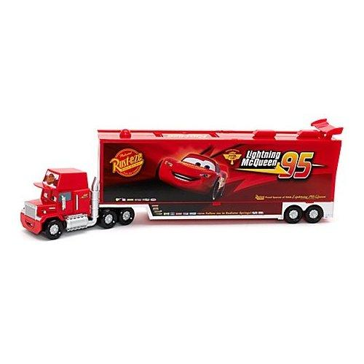
Ways to Use Sources
Illustrating – When writers use specific examples or facts from a text to support what they want to say.
Examples:
“_____ argues that ______.”
“_____ claims that ______”
“_____ acknowledges that ______”
“_____ emphasizes that ______”
“_____ tells the story of ______ “
“_____ reports that ______”
“_____ believes that ______”
A metaphor
The 18-wheeler carries lots of cargo, representing “material to think about: anecdotes, images, scenarios, data.” (Harris)

Slide 17
Example of Illustrating
from “The Early Bird Gets the Bad Grade” by Nancy Kalish:
“When high schools in Fayette County in Kentucky delayed their start times to 8:30 a.m., the number of teenagers involved in car crashes dropped, even as they rose in the state.”
In what way is this a specific example or fact? What kind of claim might it be used to support?

Slide 18
Ways to Use Sources
Authorizing – When writers quote an expert or use the credibility or status of a source to support their claims.
A metaphor
Joseph Bauxbaum, a researcher at the Mount Sinai School of Medicine, found …
According to Susan Smith, principal of a school which encourages student cell phone use, …
A study conducted by the Gulf Coast Center for Law & Policy Center, a non-profit organization which monitors environmental issues, revealed that …
What words make each person seem credible?
What claim might each quote help support?

Slide 19
Example of Authorizing
from “High schools with late start times help teens but bus schedules and after-school can conflict”
[“T]he focus on logistics is frustrating for
Heather Macintosh, spokeswoman for a
national organization called Start School
Later…. “What is the priority?” she said.
“It should be education, health and safety.”
What words make her seem credible?
What claim might this quote help support?

Slide 20
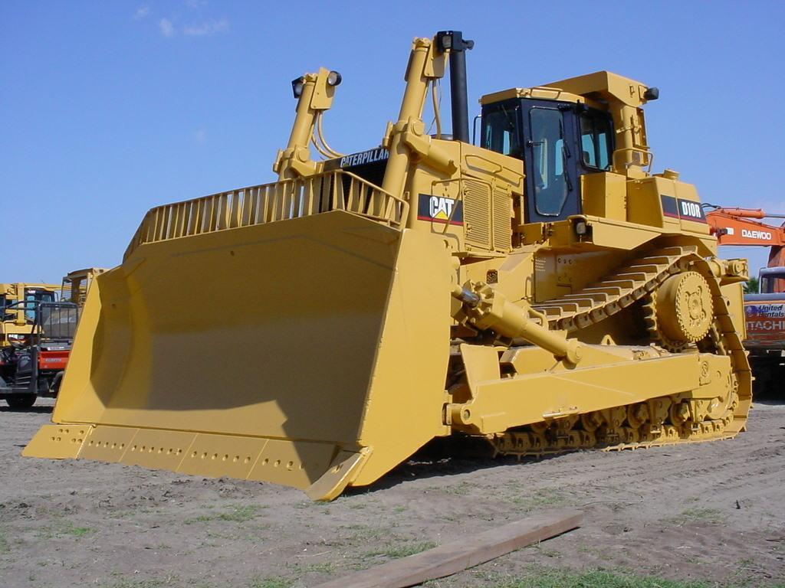
Ways to Use Sources
Countering – Countering--When a writer “pushes back” against the text in some way, by disagreeing with it, challenging something it says, or interpreting it differently than the author does.
A metaphor
What are the key elements of a good “counter”?
While parent groups often portray gaming negatively, recent brain research indicates there are positive effects.

Slide 21
Example of Countering
Acknowledge the opposition, then refute it:
While many people think ____, the research actually shows…
Or summarize the opposition, then give your case:
____ argues that ____. What the author fails to consider is … ____ says that ____. This is true, but …
____ suggests that ____. The author doesn’t explain why ….
____ argues that ____. Another way to look at this is …
____ found that ____. However, the study doesn’t explore the connections between …

Slide 22
Click HERE for a PDF file of this document.

Slide 23
Sample Guides to complete Evidence Connections…
Day 7

Slide 24
Source: WasteFreeLunches.org
Evidence from research (This is the evidence that we will use or forward, to advance our argument.) | Claim: Our school should increase its recycling efforts.
“Lunch foods cause a big trash problem. In fact, on average a school-age child using a disposable lunch generates 67 pounds of waste per school year. That equals 18,760 pounds of lunch waste for just one average-size elementary school.” A waste-free lunch could save $246.60 per school year per person. | How could we connect this piece of evidence to our purpose, to convince readers that we should increase our recycling efforts?
These pieces of evidence will be used or forwarded to ILLUSTRATE why our claim is a good one.
Notes:
Share this first example, reading the evidence and thinking aloud to show how one might connect the evidence to the claim. The next slide will show one way a writer might do this.

Slide 25
Source: WasteFreeLunches.org
Evidence from research (What we will forward, to advance our argument.) | Connection to claim: Our school should increase its recycling efforts. (This is where we’ll extend the evidence, putting our own spin on it.)
“Lunch foods cause a big trash problem. In fact, on average a school-age child using a disposable lunch generates 67 pounds of waste per school year. That equals 18,760 pounds of lunch waste for just one average-size elementary school.” A waste-free lunch could save $246.60 per school year per person. | Students at our school often bring disposable containers in their sack lunches. Encouraging everyone to use washable containers instead would reduce the amount we throw away each day.
Harris calls this extending because we’re moving beyond the information we’ve cited.
Notes:
Share this example or your own “spin” on the evidence.

Slide 26
Source: T. Pragya, “Recycling Facts for Kids”
Evidence from research (what we will forward to advance our argument.) | Claim: Our school should increase its recycling efforts. (how we’ll extend the evidence, putting our own spin on it.)
Families throw away 6 trees of paper in a year. | How could we connect the evidence to our purpose, to convince readers that we should increase our recycling efforts ?
Illustrating
Notes:
Example 2 should be done with students—either in a whole-class discussion or with students paired to work on drafting some text that extends the evidence, connecting it to the specific claim (Our school should increase its recycling efforts) and specific situation (what our school’s context is when it comes to using, wasting, or recycling paper).
You might give students a large Post-it© on which to record their attempts to put their own spin on this piece of evidence (collecting them on chart paper for review), or use a tool such as todaysmeet.com to allow students to quickly post their own efforts and see the ways their peers have attempted to extend the evidence, connecting it to the claim.

Slide 27
Source: T. Pragya, “Recycling Facts for Kids”
Evidence from research (what we will forward) | Connection to claim: Our school should increase its recycling efforts. (how we’ll extend the evidence)
Families throw away 6 trees of paper in a year. | Some of the paper we use at school is sent home in the form of notes and newsletters. We could reduce the number of notes home by posting most notices on our website instead.
Illustrating
Extending
Notes:
After students share their attempts, show this example.

Slide 28
Source:
Evidence from research | Claim:
 | Connection to Claim:
Extending
Illustrating
Notes:
Students can organize their own charts in their writers’ notebooks.

Slide 29
How are these writers using AUTHORIZING?
“James Thompson, Jr. is president of Chartwell Information, Inc., one of the first companies in the country to actually collect and publish empirical data about waste disposal and projected needs. In 1991, his company discovered that, rather than running out of landfill space, the United States had enough working landfills for over 18 years at projected capacity, more than enough to handle expected waste.”—”What Can We Expect for Future Landfill Fees and Space?” by Barbara Hudson, Chartwell Information Services. Retrieved 7-26-14 from http://www.worldsweeper.com/Disposal/v6n2landfills.html.
According to the Manhattan Institute’s Center for Energy Policy and the Environment (2008), increased regulation has eliminated many potential sites for landfills, straining our ability to dispose of waste.
Don’t forget your Signal Phrases!
Notes:
It will be helpful to provide students with copies of the quotes on slides 34-36. Using the framework provided on Slide 34, discuss the following:
First, we select a compelling piece of evidence. What is compelling about the information provided in each?
Then we identify the source of the evidence. How are the sources identified?
Finally, we show the importance of that source, if it is not obvious. What do the writers do to show the importance of the source, if anything?
We’ll return to these quotes later when we investigate countering. Some students may notice now, however, that it would be more convincing if an outside agency were pointing to the Chartwell work, rather than a publicist from Chartwell.

Slide 30
Counterclaims
Day 8

Slide 31
Countering is another move in argument writing.
First, we acknowledge a claim that is in opposition to ours.
Example: Others will argue that our school should NOT increase its recycling efforts.
Notes:
For more information about landfill space, see http://www.manhattan-institute.org/pdf/EnergyMyth_2ndEdition.pdf and http://www.worldsweeper.com/Disposal/v6n2landfills.html

Slide 32
Countering
Then, we identify evidence that our opponents might use to support their claim.
Example: Those who are against more recycling quote statistics that indicate there is no landfill shortage. They claim that “[i]f all the solid waste for the next thousand years were put into a single space, it would take up 44 miles of landfill, a mere .01% of the U.S. landspace.”—Cordato (1998)
Notes:
For more information about landfill space, see http://www.manhattan-institute.org/pdf/EnergyMyth_2ndEdition.pdf and http://www.worldsweeper.com/Disposal/v6n2landfills.html

Slide 33
Countering
Finally, we suggest a different way of thinking about their evidence:
Example: This statistic is extremely outdated, however. A quarter of a century ago, it was the best prediction of future landfill needs. More recent analyses, however, note the problem of increased regulation. These regulations have eliminated many potential sites for landfills, according to the Manhattan Institute , Center for Energy Policy and the Environment (2008).
We’re also AUTHORIZING here, as we draw on information from a recognized authority, The Manhattan Institute.
Notes:
For more information about landfill space, see http://www.manhattan-institute.org/pdf/EnergyMyth_2ndEdition.pdf and http://www.worldsweeper.com/Disposal/v6n2landfills.html

Slide 34
Practice Identifying Counterclaims
Do you know the difference between persuasion and an argument?

Slide 35
Read the article on animal testing listed as persuasive.
Then, read the article on animal testing listed as argumentative, highlighting counterclaims. Be prepared to discuss how the addition of these counterclaims better help readers to discover the truth.
Click HERE for a link to the articles in both forms.
Click HERE to review your work…

Slide 36
Now Try-it: Countering
Acknowledge the other side’s claim.
Note the evidence they are using that you want to refute.
Suggest a different way of thinking about their evidence.
Debriefing: We’ll share our efforts and talk about what worked and what might improve our attempts to counter.
Notes:
Students can work in pairs to draft sentences that do these three things—acknowledge, note, suggest.
For more information about landfill space, see http://www.manhattan-institute.org/pdf/EnergyMyth_2ndEdition.pdf and http://www.worldsweeper.com/Disposal/v6n2landfills.html

Slide 38
Use SIGNAL PHRASES to introduce information & evidence in your writing.
Think about ways to add information from a source to your writing. Use a sentence starter to add evidence and then explain your thinking.
Agree | “As _____ says,” “The video text explains …” “According to …” “Supporting my example, …”
Disagree | “Although the video says …” “While the video text explains …”
Beth Rimer, Ohio Writing Project for NWP CRWP funded by the Department of Education
Notes:
Day 2
ways we add information from a source to our writing:

Slide 39
Compose your Argument
Need additional help with the formatting of your argument?
Utilize the Assertion-Evidence-Application Pattern file to guide you; click HERE.
Day 9

Slide 40
The 40 Minute Kernel Essay
Attention grabber and my claim on the Issue
But this fact really convinces me
Here's what I’ve learned
I now believe

Slide 41
Revising
Look for what is missing in your efforts to use sources effectively and focus your revision on trying at least one additional “move”:
Distinguishing between your own ideas and the source material by using quotation marks or signal phrases
Commenting on the source material
Noting the credibility of the source
Connecting the source material to the overall claim, explaining how and why the evidence helps support the claim
Using specific examples from the text to support the claim
Putting “spin” on terms and ideas taken from other texts (counterclaims)
Disagreeing with a text, challenging something it says, or interpreting it differently

Slide 42
Peer Review
Day 10

Slide 43
Evaluation Rubric

